Slide 1

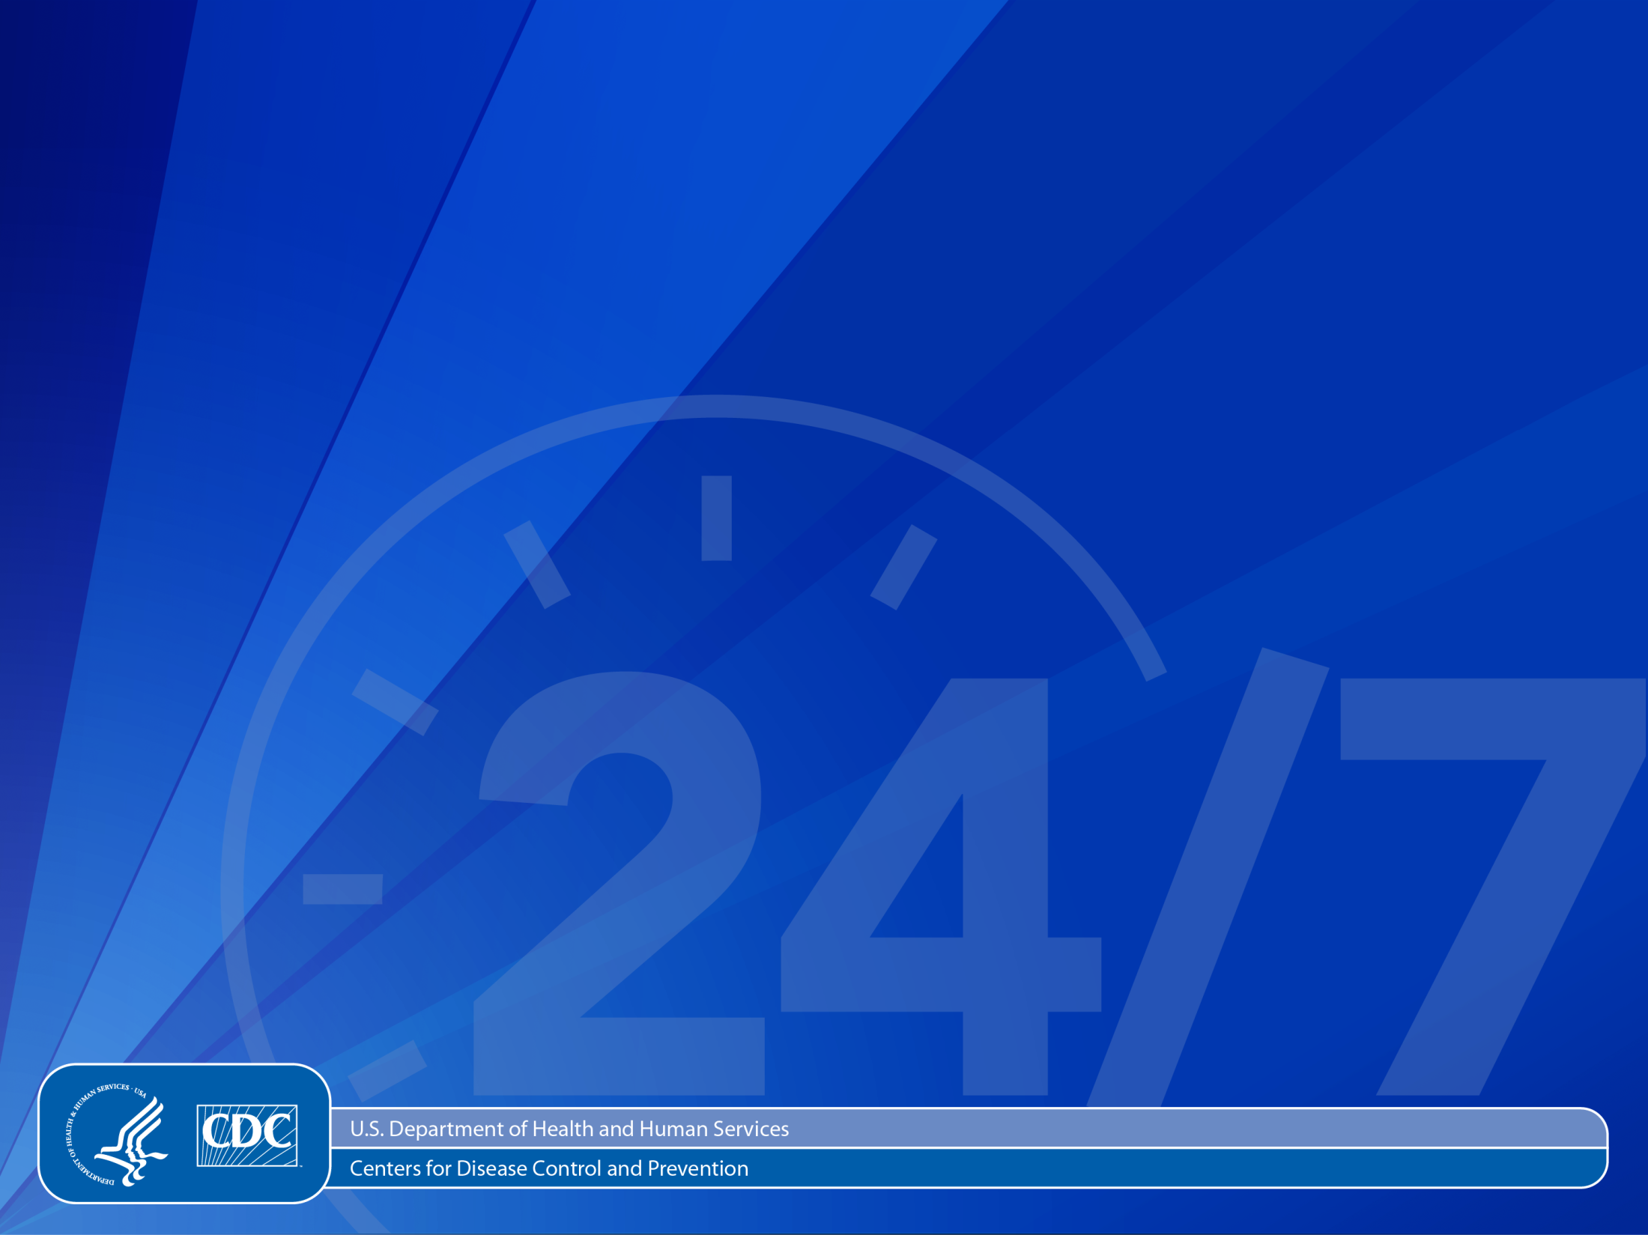
Public Health Financing
CDC Office for State, Tribal, Local and Territorial Support
and
CDC Procurement and Grants Office
June 2013

Slide 2
Learning Objectives
Understand and describe
Major sources of public health funding
Major players and their roles in the budget process
The role of Congressional intent and funding parameters on the flow of funding from the federal to the state, tribal, local, and territorial levels, and beyond
Sources of federal budget information
How grants and cooperative agreements are used to put appropriations into practice
How a funding opportunity announcement (FOA) is used to make potential applicants aware of funding availability

Slide 3
The Federal Budget Process

Slide 4
Background

Slide 5
How Public Health Is Financed
Most common sources
Federal funds
Mixture of population-based formula grant programs, incidence- or prevalence-based formulas, and a series of competitive grants
State and local funds
Varies dramatically based on state governance and health department structure/activities
County and city revenues
Also quite variable
Trust for America’s Health. Investing in America’s Health. March 2012.
http://healthyamericans.org/report/94/

Slide 6

State Health Agency Funding, by Source (n=48)
As of Sept 2011

Slide 7
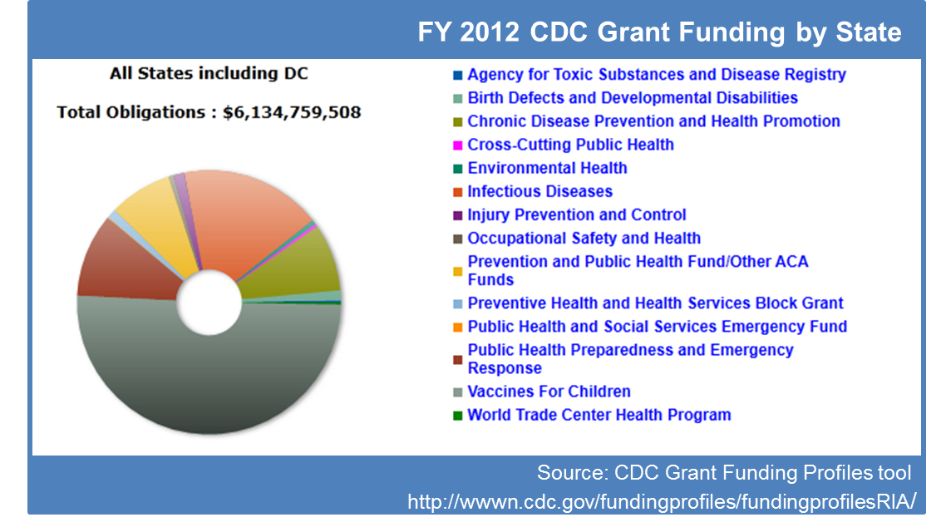

Slide 8
Factors Influencing Flow of Funding from Federal to Other Levels
Congressional authorizations and appropriations directives/limits
Eligibility varies by funding opportunity
Not all eligible apply for each opportunity

Slide 9
Factors Influencing Flow of Funding from Federal to Other Levels
Most federal funding awarded via a competitive or merit-based process; not all that apply are funded
Some funding allocated according to a pre-set formula, which is sometimes specified in law

Slide 10
Reach of Federal Funding
Awards can be made directly to health departments at all levels, nonprofits, academia, businesses, community organizations, etc.
Awards made to state-level entities may be shared with local entities and/or benefit the whole state
Awards to national associations are used to carry out national public health programs and may include sub-awards to other entities

Slide 11
Reach of Federal Funding
CDC fellowships and direct placement of CDC staff supports the public health workforce at all levels
CDC guidelines, trainings, toolkits, technical assistance, etc., for the field extend the reach of
in-house CDC resources
Public health law technical assistance, trainings, health IT, Epi-Aids, outbreak investigation and response, etc.

Slide 12
Federal Budgets: the Bottom Line

Slide 13
Federal Agency Budgets: The Bottom Line
Only Congress can raise revenue, borrow funds, and provide funding to Federal agencies
Congress decides:
What each agency is authorized to do
Purpose of the funds
Amount of funds
Amount of time the funds are available to be spent
Other parameters as desired (e.g., who is to receive funding from the federal agency; what agencies and their grantees CANNOT do with federal funds)
Notes:
Example of what CAN’T do: Neither the federal government nor its grantees or contractors can use federal funds to lobby or advocate.
Lobbying/advocating = lobbying or advocating for policies or legislation, or asking others to advocate (grassroots lobbying)

Slide 14
Federal Agency Budgets: The Bottom Line
Federal agencies
Create spend plans that adhere to Congressional intent and funding parameters
Use the intent and parameters to inform development and implementation of grants, cooperative agreements, and contracts
Grantees and contractors
Must adhere to the same intent, parameters, and limits (Congressional and additional parameters specified by the funding federal agency)
Must assure that any sub-grants or sub-contracts also adhere

Slide 15
Federal Budget Process

Slide 16
The Fiscal Year
Federal fiscal year (FY)
Starts October 1 of each year
Ends September 30 of the next year
FY13 = October 1, 2012–September 30, 2013
State, territory, local, and tribal governments, and other types of grantees have their own fiscal cycles

Slide 17
Congress Holds the Power of the Purse
Congress authorizes activities and appropriates funding for all federal agencies
Federal agencies
Must have the necessary Congressional authorities and appropriations for all activities conducted
Must adhere to the Congressional purpose for the funds
Cannot obligate funds before Congress passes the appropriation
Cannot exceed the funding timeframe or amounts set by Congress

Slide 18


Module 2: The Philosophy of Appropriation Law
Animation
The Three Dimensions of Appropriation Law
Understanding an Appropriation Act
3
Amount
1
Purpose
SOCIAL SERVICES BLOCK GRANT
For making grants to States pursuant to section 2002 of the Social Security Act, $2,800,000,000. For carrying out section 2007 of the Social Security Act, an additional $1,800,000,000, which shall remain available until expended.
2
Time
Notes:
Let’s look at an example of appropriation language for a Social Services Block Grant that clearly states the three dimensions of appropriations law: purpose, time, and amount.
SOCIAL SERVICES BLOCK GRANT
“For making grants to States pursuant to section 2002 of the Social Security Act, $2.8 billion. For carrying out section 2007 of the Social Security Act, an additional $1,800,000,000, which shall remain available until expended.”
The Purpose is “For carrying out section 2007 of the Social Security Act”
The Amount is “1.8 billion”
The Time “is available until expended”

Slide 19
Congress May I…? Authorizing Legislation
Gives federal agencies the authority to operate
Defines activities federal programs are authorized to perform
Can be time-limited
Can receive new authorities from Congress at any time
Public health authorities are listed in the Public Health Service Act (Title 42 of USC)
Cited in agencies’ annual budget proposals, funding opportunity announcements (FOAs), etc.

Slide 20
Ways CDC Receives Congressionally Authorized/Appropriated Funding
Annual appropriations process
Individual pieces of Congressional legislation appropriating funding, anytime during the FY
User fees that Congress authorizes CDC to collect for services (e.g., CDC’s Vessel Sanitation Program)
Transfers from other federal agencies
Funded activities must still fall under CDC’s specific authorities
Funds must be used according to original Congressional intent and other parameters put on those funds

Slide 21
The Formal Players
President
Office of Management and Budget
HHS Secretary
CDC Director and Leadership
CDC Programs
Congress
Notes:
Will not cover today the informal players: other stakeholders, including special interests (advocacy or lobbying groups)
CDC is an agency under the Department of Health and Human Services (HHS). In turn, HHS is a Department that falls within the Executive Branch. The President is the head of the Executive Branch. Therefore, in a nutshell, the chain of command/relationships between the President, HHS, and CDC in budget development is this:
The President provides HHS with direction, priorities, and guidance for developing HHS’ annual budget
In turn, HHS provides HHS-specific guidance to CDC
Next, the CDC Director/Leadership will provide tailored guidance to CDC programs
This means some parameters for developing a budget are set at levels higher than individual CDC programs
CDC programs develop their budget requests based on all of the guidance received, CDC programmatic expertise (i.e., the science), and knowledge of stakeholder needs
HHS and the President (through OMB) review and approve CDC’s budget submission
This means the President has final say over what is submitted to Congress for consideration
The President submits his US budget request to Congress, usually on the first Monday in February every year
This submission serves as one of the inputs Congress uses to draft its appropriations bills

Slide 22
Congressional Appropriations Committees
House and Senate have a standing committee and subcommittees for appropriations
HHS (and thus CDC) falls under the “Labor, Health and Human Services, Education and Related Agencies” subcommittees in House and Senate
Committees draft and approve appropriations bills for consideration/passage by Congress

Slide 23
Phases of Federal Budget Process
Strategic Plan
Formulation
Presentation
Execution
Performance
Future Strategic Direction
Notes:
Strategic Plan: Identifies new initiatives and expands existing programs.
Formulation: Prepares budget estimates and justifications based on guidelines provided by Congress, OMB, and HHS.
Presentation: Justifies budget request before Congress and responds to questions.
Execution: Develops apportionments, spending plans, allotments, allowances, and obligates funds.
Performance: Evaluation and Analysis ─ determines if the expected results were achieved.
Future Strategic Direction: Performance results determine future funding decisions.
At any given time, federal agencies are working on different for three budget years.
For example, we are currently:
1. Implementing the FY13 plan
2. In the presentation phase for FY14 (e.g., engaging in Congressional hearings and answering questions re FY14 request)
3. Developing FY15 request

Slide 24
Congressional Justification (CJ)
How CDC requests fiscal year (FY) operations and program budgets
Justify resources
How much, how used, how managed, how to measure impact
3 development phases
CDC budget request to HHS
HHS request to Office of Management and Budget
President request to Congress (usually 1st Monday of February)
Contains
Results of past FY
Proposal and justification for upcoming FY budget and activities
How will measure performance and provide targets for upcoming FY

Slide 25
Budget Implementation
Develop Funding Opportunity Announcements/Requests for Contracts compliant with intent and specifications of Congress in authorizing and appropriations bills
Ensure CDC and grantee compliance with authorizing and appropriations language, fiscal and other policies
Identify and mitigate risks to achieving CJ performance measures
Retire or revise current measures or create new performance measures as needed
Notes:
All Funding Opportunity Announcements (FOAs) and Requests for Contracts (RFC) must map back to a Congressional authority and appropriation.

Slide 26
Resources

Slide 27
Resources
CDC
Budget (CJ and related resources)
www.cdc.gov/fmo/topic/Budget%20Information/index.html
Grant Funding Profiles Tool wwwn.cdc.gov/FundingProfiles/FundingProfilesRIA/
Public Health System Financing
www.cdc.gov/stltpublichealth/GrantsFunding/index.html
President’s Budget
www.whitehouse.gov/omb/budget
US Budget
Copies (GPO)
www.gpo.gov/fdsys/browse/collection.action?collectionCode=BUDGET
Process (US Senate)
www.rules.senate.gov/public/index.cfm?p=BudgetProcess

Slide 28
After CDC receives funding, what happens next?

Slide 29
Next Steps…
CDC receives its funding from Congress, through the Office of Management and Budget (OMB) and HHS. CDC receives its funding through 14 separate funding lines/treasury symbols, which correspond loosely to CDC’s Centers, Institutes, and Offices (CIOs).
After CDC’s Office of the Chief Financial Officer (OCFO) distributes the fiscal year ceiling memoranda to each CIO, spending plans are implemented.

Slide 30
Next Steps…
The CIOs will allocate funds to various programs and for extramural funds, and will determine, in conjunction with the Procurement and Grants Office (PGO) staff, whether to use grants, cooperative agreements, or contracts to carry out the purpose of the program.
Notes:
Other CIOs have the capability to help fund the PHAP program.

Slide 31
Grants and Cooperative Agreements
Grant —is most appropriate when the principal purpose is to transfer a thing of value, money, property, or services to the recipient to carry out the public purpose and little involvement is expected on the part of the issuing agency.
– A grant requires the completion of program activities by the funded organization only.
Cooperative Agreement—is used when the principal purpose of the relationship is to transfer a thing of value and the agency is expected to provide substantive involvement in carrying out the activities.
–A Cooperative Agreement includes substantial participation on the part of CDC.
Notes:
Grants and Cooperative Agreements are funding mechanisms. A funding mechanism is the type of funded application or transaction used at the CDC. Programs are areas within the funding mechanisms.

Slide 32
Funding Opportunity Announcement (FOA)
CDC utilizes grants and cooperative agreements to assist other health-related and research organizations that contribute to CDC’s mission and accomplish their goals.
High-quality FOAs can improve the performance of programs, accountability, science, and research.
Most awards are made thorough a competitive process. The process begins with the FOA.
Notes:
Another way CDC Funds can be used.

Slide 33
Funding Opportunity Announcement (FOA)
FOAs are public notifications used to announce the availability of discretionary financial assistance.
FOAs are announced to maximize the opportunity for competition.
The published FOA provides potential applicants the information they need to determine whether they are eligible to apply and how to apply (www.grants.gov), as well as outlining the types of activities CDC wants the applicants to carry out.
Notes:
By issuing a FOA, an agency notifies the public of the availability of funding.
Applicants can apply through Grants.gov.

Slide 34
FOA Components
The following components are included in the FOA:
FOA description (purpose, outcomes, requirements)
Award information (amount of the award, duration of the award, duties and responsibilities of the grantee)
Eligibility information
Application and submission information
Application review information
Award administration information
Agency contacts
Additional information
Notes:
This information can be found on Grants.gov under an FOA.

Slide 35
FOA Application Process
Applications are received through www.grants.gov
Applications are reviewed and scored through an objective or peer review process for most FOAs
Funded applications
Note: “Approved” applications may not be funded, depending on the amount of funds available and other funding preferences as outlined in the FOA

Slide 36
Scoring of Applicant Proposals
The following sections of the application are scored:
Program Plan
Statement of Need
Experience and Commitment of Key Personnel
Management Plan
Past Performance
Notes:
There are several other directions listed within the FOA that must be followed by the applicant in order to be eligible for funding consideration.

Slide 37
Award Notice
Applicants selected for funding support will receive a Notice of Award (NoA) signed by the respective PGO Grants Management Officer for that CIO.
The notice serves as an authorizing document for the awardee to begin work and expend funds.

Slide 38
Reporting
A successful applicant will submit reports as required and outlined in the FOA. Usually, there are quarterly progress reports, a final report, and a final financial status report.
Notes:
The purpose of the quarterly and final reports is to provide accurate and timely program information to program managers and to respond to Congressional, Departmental, and public requests for information about the program.

